Slide 1

Gordon Matthewson*, Choong-Wan Woo*, Marianne C. Reddan, Tor D. Wager (2019) Cognitive self-regulation influences pain-related physiology, Pain *co-first authors
Link to Paper in Pain
Link to Biorxiv preprint
Link to Video Abstract
Code and data: https://github.com/canlab/cognitive_regulation_physiology
Included slides:
Summary slides for video abstract
Slides with paper figures and supplementary figures
Notes:
If you’re like me, you want to make the world a better place. I want to understand pain and emotional distress, and design interventions that will help.
I believe many of you share the same goal – to help patients with depression, anxiety, substance use problems recover and live healthy lives.
But the space of possible interventions is vast… and if we don’t know why symptoms arise, it’s unclear how to treat them. Consider the Ebers Papyrus…

Slide 2
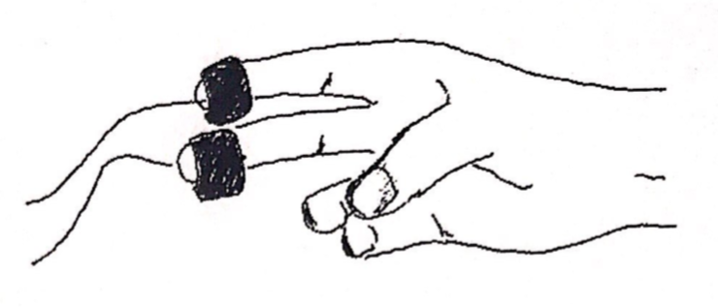
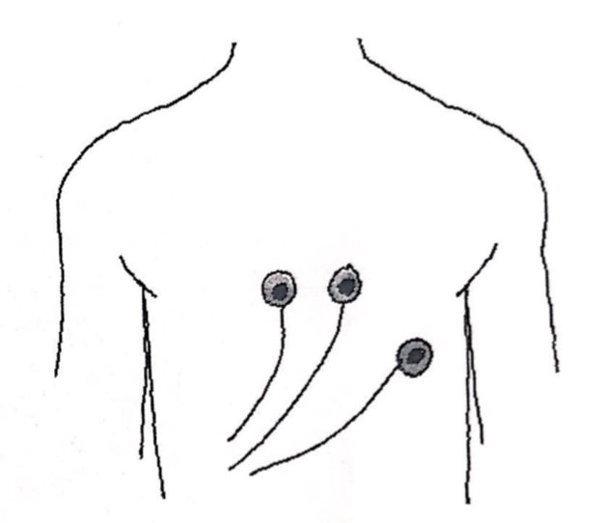
Cognitive effort
design
development
validation
Skin conductance response
Cue
★
2s
Anticipation
+
Null findings
6s
Thermal
Stimulation
10s
+
(Rest)
14s
Heart rate
Pain rating
4s
+
(Rest)
10s
Pain regulation

Slide 3
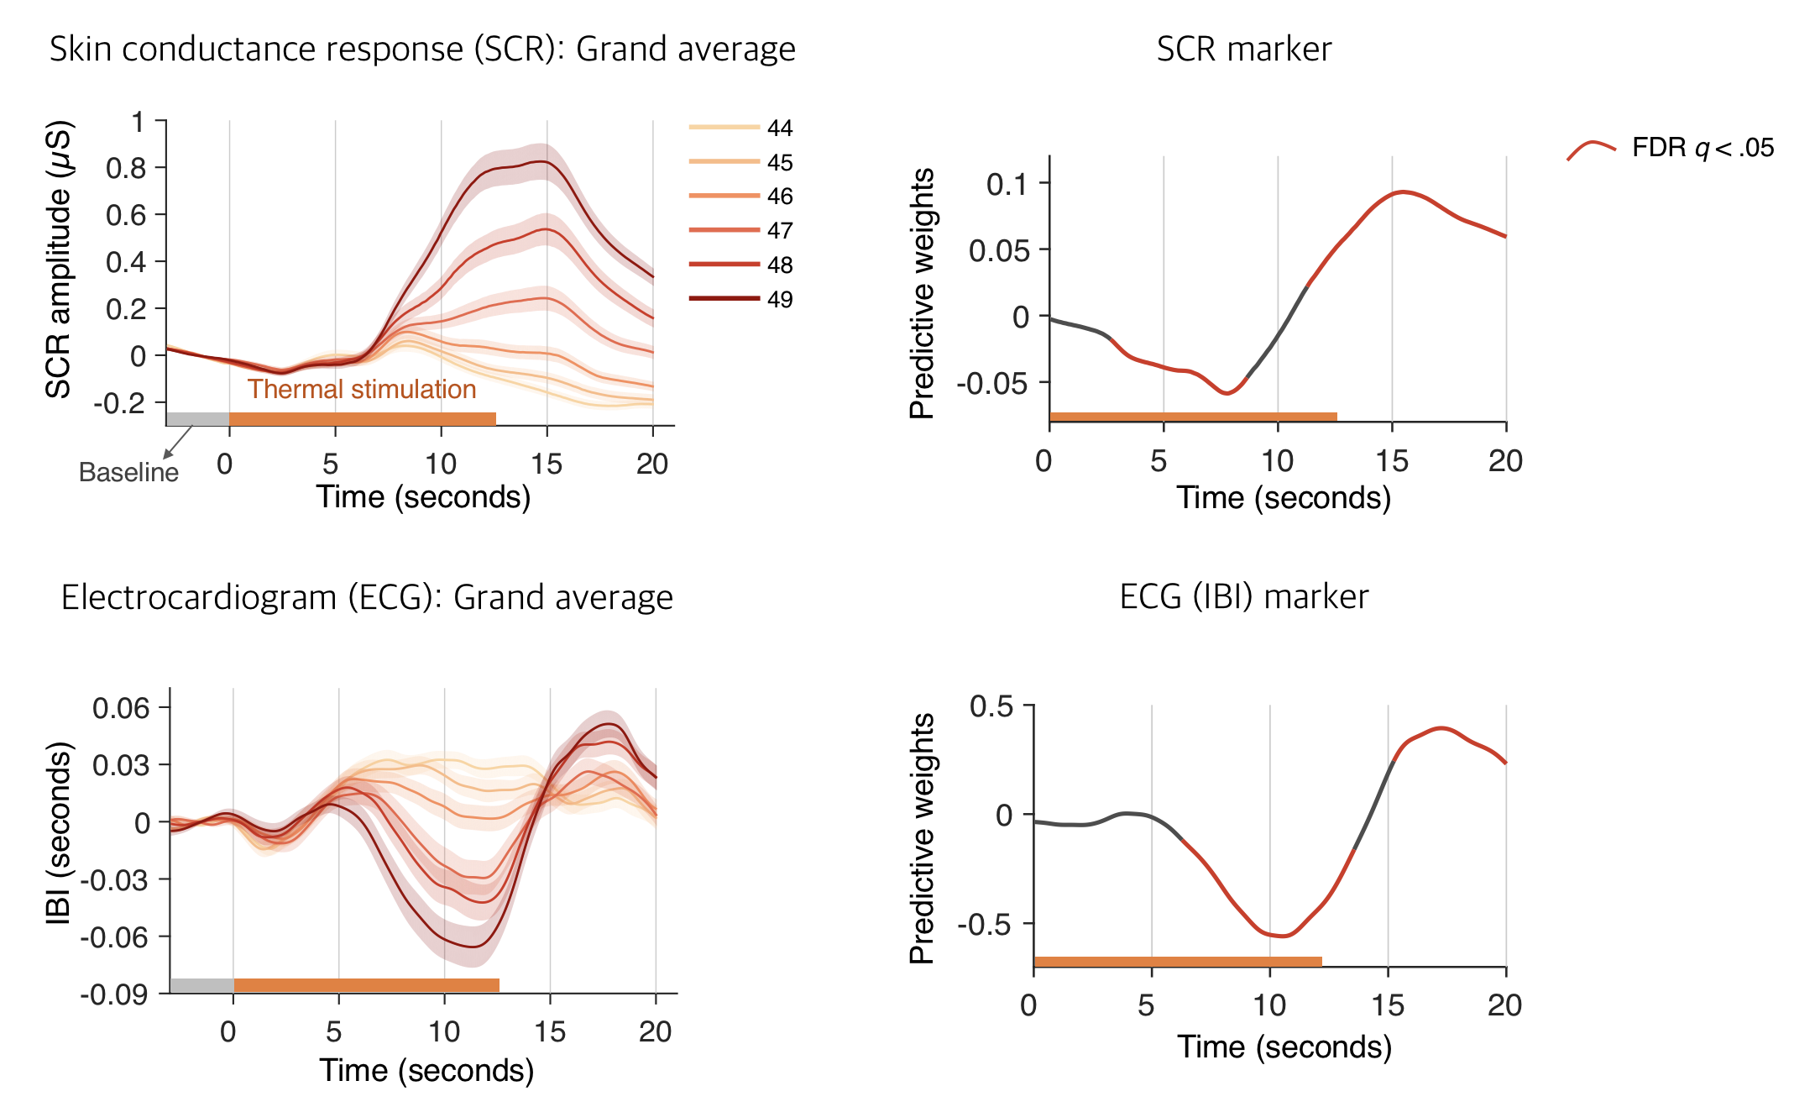
Figure 3 of the paper
design
development
validation
ºC
higher
faster
Cue
★
2s
Anticipation
+
6s
Thermal
Stimulation
10s
+
(Rest)
14s
Pain rating
4s
+
(Rest)
10s

Slide 4
Figure S3 of the paper
design
development
validation
Cue
★
2s
Anticipation
+
6s
Thermal
Stimulation
10s
+
(Rest)
14s
Pain rating
4s
+
(Rest)
10s

Slide 5
Figure 3 of the paper
design
development
validation
Physiological markers for pain
Cue
★
2s
Anticipation
+
higher
faster
6s
Thermal
Stimulation
10s
+
(Rest)
14s
Pain rating
Thermal stimulation
4s
+
(Rest)
10s

Slide 6
Figure 4 of the paper
Model performance
(Leave-one-subject-out cross-validation)
a
SCR pain intensity model
b
ECG pain intensity model
Mean r = 0.82
Mean r = 0.67
r = 1
Prediction-outcome
correlation
Predicted pain intensity
Predicted pain intensity
r = 0
r < 0
....
x = y line
Actual pain intensity
Actual pain intensity
c
d
SCR unpleasantness model
ECG unpleasantness model
Mean r = 0.73
Mean r = 0.65
Predicted unpleasantness
Predicted unpleasantness
Actual pain unpleasantness
Actual pain unpleasantness

Slide 7
Figure 5 of the paper
Physiological response
Model response
Participants experiencing pain (pain receiver)
Partners observing pain (pain observer)
Pain receiver
Pain observer
***
***
***
SCR amplitude (µS)
SCR marker response
ns
***
ns
SCR amplitude (µS)
Thermal stimulation
Thermal stimulation
Baseline
Time (seconds)
Temperature (ºC)
Time (seconds)

Slide 8
Figure 2 and 7 of the paper
Behavioral results
Effect magnitude
1 unit = the effect magnitude of 1˚C change in each model
***
Relative effect magnitude
***
***
***
***
***
Ratings: pain intensity
SCR: pain intensity
ECG: pain intensity
SCR: pain unpleasantness
ECG: pain unpleasantness
Ratings: pain unpleasantness

Slide 9
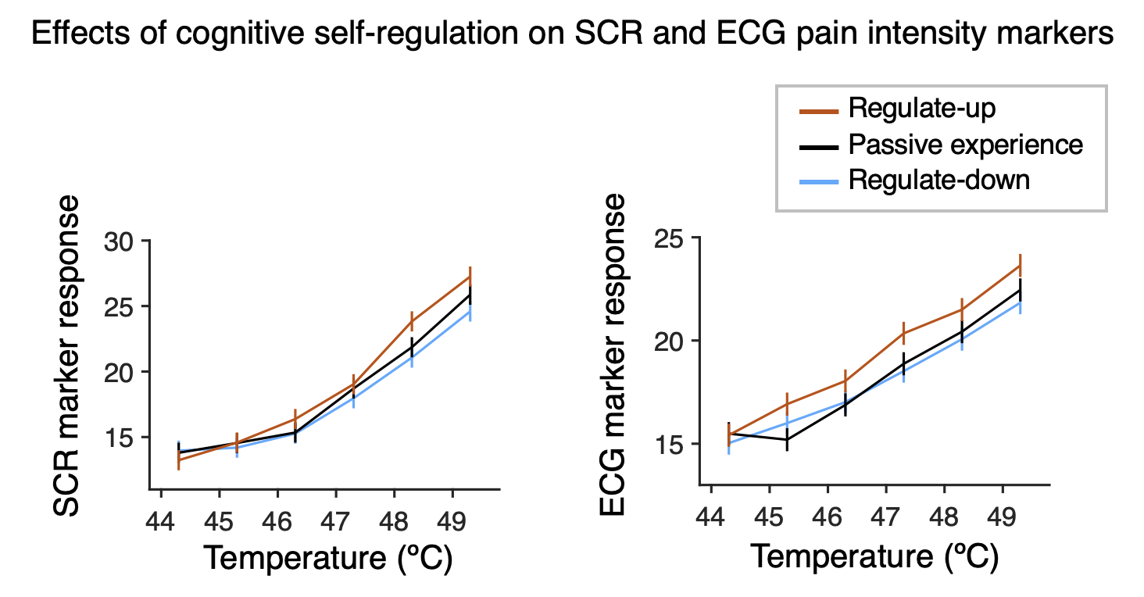
Figure 6 and 7 of the paper
Cognitive regulation effects on the physiological markers
Effect magnitude
1 unit = the effect magnitude of 1˚C change in each model
***
Relative effect magnitude
***
***
***
***
***
Ratings: pain intensity
SCR: pain intensity
ECG: pain intensity
SCR: pain unpleasantness
ECG: pain unpleasantness
Ratings: pain unpleasantness

Slide 10
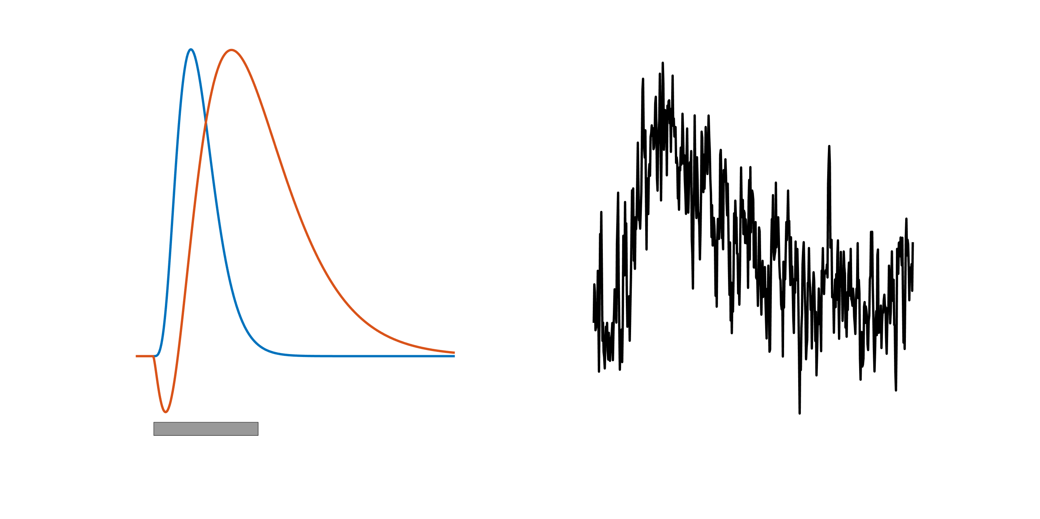
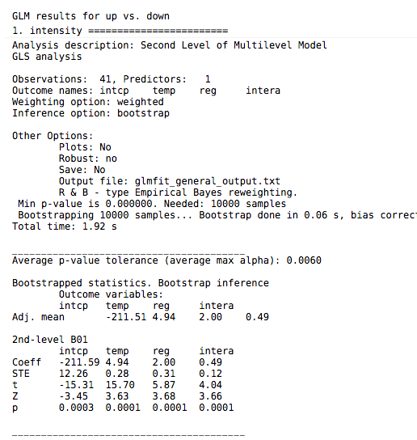
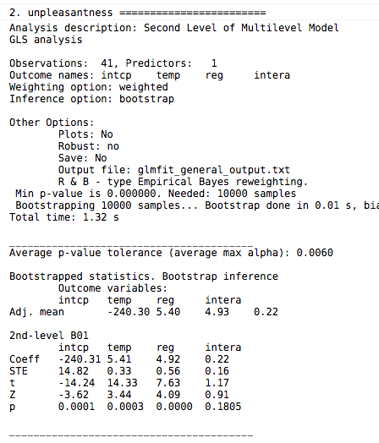
Figure 1
a
Components
Noisy observed signal
Orienting-related
Data generation process
Pain-related
Analysis goal
b
Pain-related
component
3 task conditions
Analysis 1
Passive experience
SCR
Develop physiological markers predictive of pain ratings
ECG
Study 1
Regulate-up
Regulate-down
Analysis 3
Test the effects of self-regulation on the physiological markers
2 group conditions
Experiencing pain
Analysis 2
Study 2
SCR
Validate the SCR marker’s generalizability and specificity
Observing pain
Notes:
A) Concept behind component-based analysis. Like other complex signals, autonomic responses may be composed of multiple underlying signals mixed together. Here, two components are illustrated, one unrelated and another related to pain reports. The observed signal is a mixture of the two plus noise. The gray bar shows the stimulus period. The goal of component-based analysis is to recover the underlying signals. In this case, we aimed to identify a waveform correlated with pain reports, separating this to the extent possible from non-pain-related signal and noise components. This allowed us to test self-regulation effects on the amplitude of the pain-related component for each participant.

Slide 11
Figure 2
a
Pain intensity and unpleasantness
Regulate-up
Passive experience
Regulate-down
Intensity
Unpleasantness
Temperature (ºC)
Temperature (ºC)
b
GLM results
Pain intensity
Pain unpleasantness
Effect magnitude
***
***
Effect magnitude
***
***
***
Interaction
Interaction
Regulation
Regulation
Temperature
Temperature

Slide 12
Figure 3
a
Skin conductance response (SCR): Grand average
c
SCR time-course that is predictive of pain intensity and unpleasantness
FDR q < .05
Not significant
Pain intensity
Pain unpleasantness
SCR amplitude (µS)
Predictive weights
Predictive weights
Thermal stimulation
Baseline
Time (seconds)
Time (seconds)
r = .998
Time (seconds)
b
Electrocardiogram (ECG): Grand average
of inter-beat interval (IBI)
d
ECG (IBI) time-course that is predictive of pain intensity and unpleasantness
Pain intensity
Pain unpleasantness
IBI (seconds)
Predictive weights
Predictive weights
Time (seconds)
r = .855
Time (seconds)
Time (seconds)
Notes:
add rise and plateau info here.

Slide 13
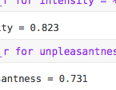
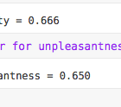
Figure 4
a
SCR pain intensity model
b
ECG pain intensity model
Mean r = 0.82
Mean r = 0.67
r = 1
Prediction-outcome
correlation
Predicted pain intensity
Predicted pain intensity
r = 0
r < 0
....
x = y line
Actual pain intensity
Actual pain intensity
c
d
SCR unpleasantness model
ECG unpleasantness model
Mean r = 0.73
Mean r = 0.65
Predicted unpleasantness
Predicted unpleasantness
Actual pain unpleasantness
Actual pain unpleasantness

Slide 14
Figure 5
a
Participants experiencing pain (pain receiver)
b
Partners observing pain (pain observer)
c
**
***
***
**
Pain receiver
47 ºC
48 ºC
49 ºC
47 ºC
48 ºC
49 ºC
Pain observer
***
SCR amplitude (µS)
SCR peak amplitude
***
SCR amplitude (µS)
Thermal stimulation
Thermal stimulation
Baseline
Time (seconds)
Time (seconds)
Temperature (ºC)
d
e
f
Pain receiver
Pain observer
***
Pain ratings from pain receivers
***
*
SCR marker response (pain receivers)
***
SCR marker response (pain observers)
***
***
very strong
SCR marker response
ns
***
ns
Pain intensity rating
strong
Classification accuracy
moderate
weak
49 vs. 47
48 vs. 47
49 vs. 48
Temperature (ºC)
Temperature (ºC)
Classification contrasts

Slide 15
Figure 6
a
Effects of cognitive self-regulation on SCR and ECG pain intensity markers
Regulate-up
Passive experience
Regulate-down
SCR marker response
ECG marker response
Temperature (ºC)
Temperature (ºC)
b
GLM results
SCR pain intensity marker
ECG pain intensity marker
***
***
***
***
Effect magnitude
***
Effect magnitude
*
Interaction
Interaction
Regulation
Regulation
Temperature
Temperature

Slide 16
Figure 7
a
b
1 unit = the effect magnitude of 1˚C change in each model
1˚C change
***
***
***
Regulate-up
**
**
+
+
Relative effect magnitude
Relative effect magnitude
ns
***
***
***
+
ns
ns
***
***
***
***
down
Ratings: pain intensity
SCR: pain intensity
ECG: pain intensity
Ratings: pain intensity
SCR: pain intensity
ECG: pain intensity
SCR: pain unpleasantness
SCR: pain unpleasantness
Ratings: pain unpleasantness
ECG: pain unpleasantness
Ratings: pain unpleasantness
ECG: pain unpleasantness

Slide 17
Figure S1
a
Skin conductance response
b
Electrocardiogram: inter-beat interval
SCR amplitude (µS)
IBI (seconds)
Time (seconds)
Time (seconds)
Notes:
add rise and plateau info here.

Slide 18
Figure S2
SCR intensity
SCR unpleasantness
ECG intensity
ECG unpleasantness
# components of the final model
Prediction-outcome correlation
Number of principal components

Slide 19

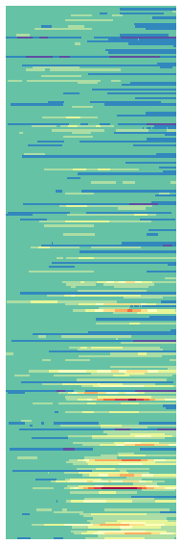
Figure S3
a
Preprocessing
SCR
Peak detection and
inter-beat interval calculation
Low-pass filter
SCR: 5 Hz
ECG: 1 Hz
Down-sample to 25Hz
Inter-beat interval
Grand
average
ECG
b
Grand average (Example of SCR data)
c
Prediction approach
SCR during
passive experience runs
Subtract baseline
for each trial
Pain ratings
high
44ºC
SCR amplitude (µS)
low
45ºC
Testing on
the data from regulation and passive experience
runs of the
left-out participant
Training
Testing
Time (seconds)
Principal
component
regression
46ºC
SCR amplitude (µS)
246
Average across
individuals
with leave-one-participant-out cross-validation (training a model except for one participant’s data)
47ºC
SCR amplitude (µS)
48ºC
Baseline
49ºC
Time (seconds)
Time (seconds)
500

Slide 20
Figure S4
a
Effects of cognitive self-regulation on SCR and ECG unpleasantness markers
Regulate-up
Passive experience
Regulate-down
SCR marker response
ECG marker response
Temperature (ºC)
Temperature (ºC)
b
GLM results
SCR pain unpleasant marker
ECG pain unpleasantness marker
***
***
***
Effect magnitude
***
Effect magnitude
***
Interaction
Interaction
Regulation
Regulation
Temperature
Temperature

Slide 21
Figure S5
a
Regulation strategies
4.8%
4.8%
6.8%
9.1%
External focus of attention
23.8%
Pleasant imagery
61.9%
31.8%
Unpleasant imagery
Regulate-
up
Regulate-
down
25.0%
Dramatized coping
4.8%
Rhythmic cognitive activity
Pain acknowledging
Breathing activity

Slide 22
Figure S6
a
3 conditions of runs
Regulate-up
Passive experience
Regulate-down
Figure 1. Experimental design.
1
2
3
4
5
6
7
8
9
Runs 1-9
Run
structure
Pre-run heat (49ºC)
Regulation instruction
Pain trial
Pain trial
Pain trial
b
Regulation reminder
Trial
structure
Pain trial
Pain trial
Pain trial
Thermal
Stimulation
12.5s
Jitter
2-16s
Pain rating
Intensity
gLMS
Pain rating
unpleasantness
gLMS
ITI
6-14s
Intensity and unpleasantness ratings were counterbalanced across trials
Physiology measures: Skin Conductance Response (SCR)
Electrocardiogram (ECG)

Slide 23
Figure S7
The SCR models from the current study dataset
Pain intensity
Pain unpleasantness
Predictive weights
Predictive weights
Time (seconds)
r = .998
Time (seconds)
FDR q < .05
r = .971
r = .981
Not significant
from Geuter et al. (2014)
Predictive weights
Time (seconds)

